Slide 1
EES203: Geochemistry
Instructor: Anoop Ambili
Email id: anoop@iisermohali.ac.in

Slide 2
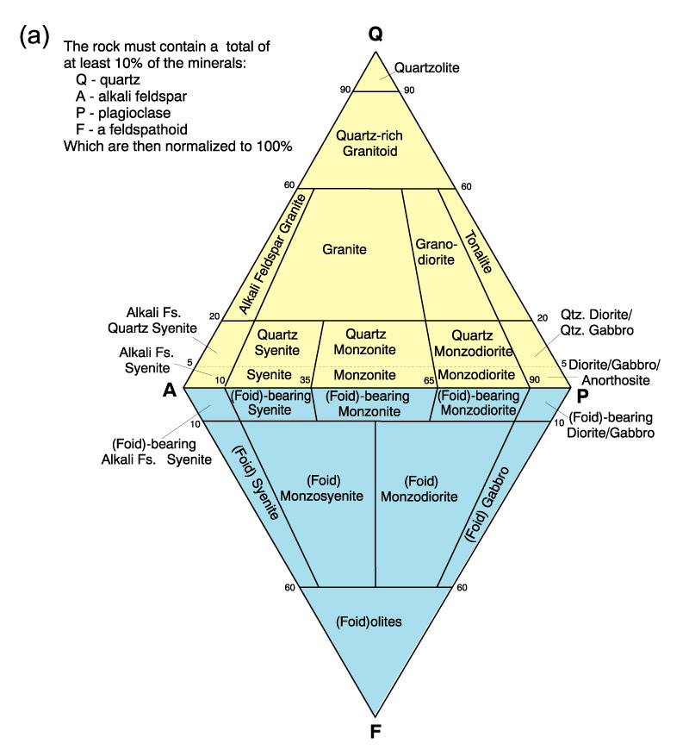
Classification of Igneous Rocks
Figure 2.2a. A classification of the phaneritic igneous rocks: Phaneritic rocks with more than 10% (quartz + feldspar + feldspathoids). After IUGS.

Slide 3
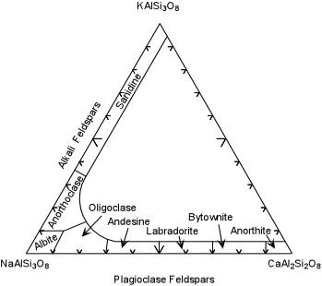
Feldspars have names for very specific ranges of composition. Most cannot be identified in hand specimens.

Slide 4
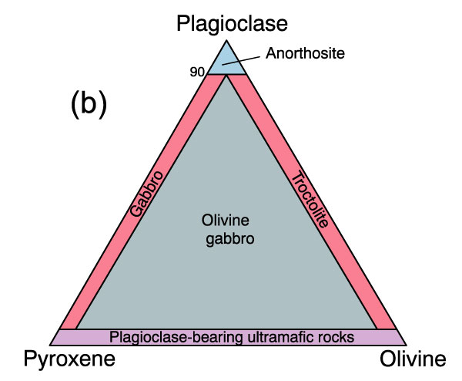
Classification of Igneous Rocks
Figure 2.2b. A classification of the phaneritic igneous rocks: Gabbroic rocks. After IUGS.

Slide 5
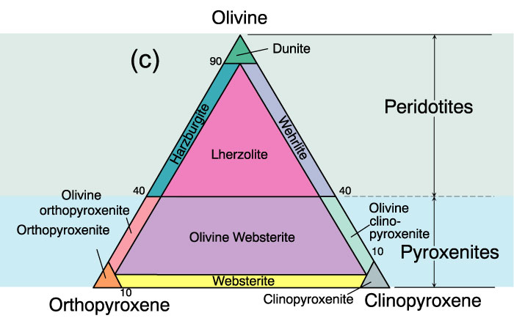
Classification of Igneous Rocks
Figure 2.2c. A classification of the phaneritic igneous rocks: Ultramafic rocks. After IUGS.

Slide 6
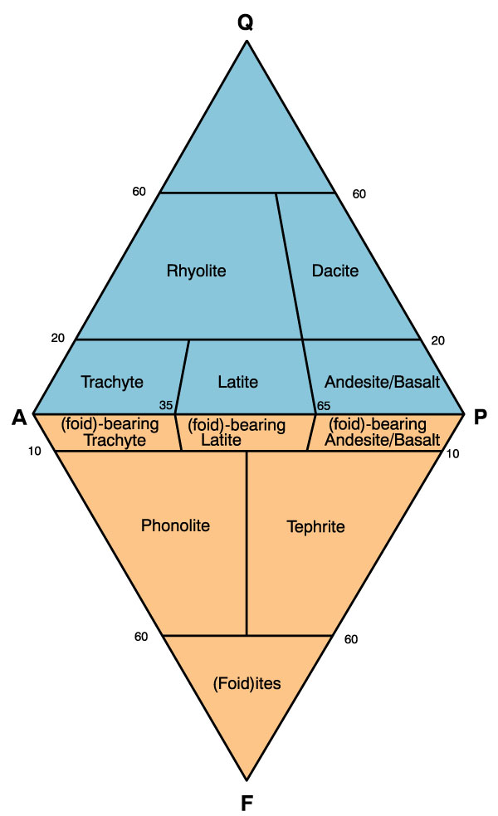
Classification of Igneous Rocks
Figure 2.3. A classification and nomenclature of volcanic rocks. After IUGS.

Slide 7
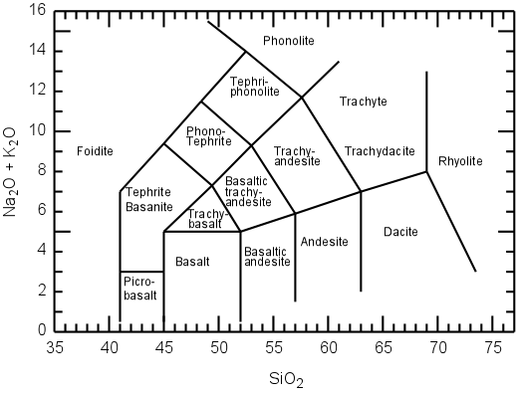
Classification of Igneous Rocks
Figure 2.4. A chemical classification of volcanics based on total alkalis vs. silica. After Le Maitre (2002) . Igneous Rocks: A Classification and Glossary of Terms. Cambridge University Press.

Slide 8
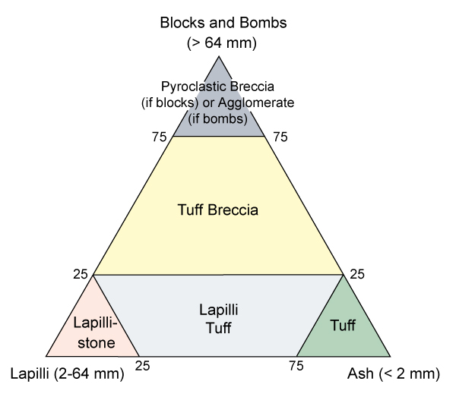
Classification of Igneous Rocks
Figure 2.5. Classification of the pyroclastic rocks. After Fisher (1966) Earth Sci. Rev., 1, 287-298.

Slide 9
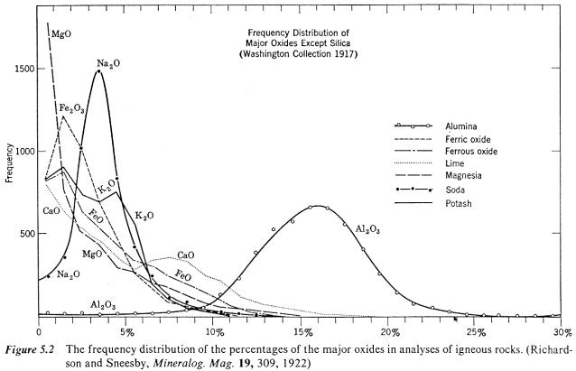
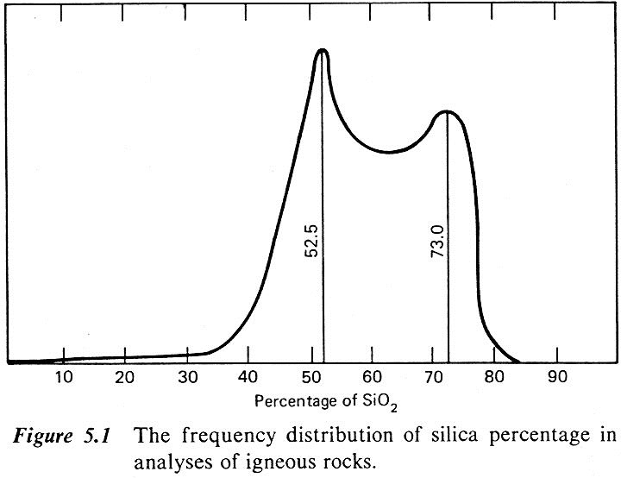
Igneous geochemistry
SiO₂ content in igneous rocks is bimodal, as is CaO and K₂O
Each of the other major element oxides has one
dominant range of composition

Slide 10
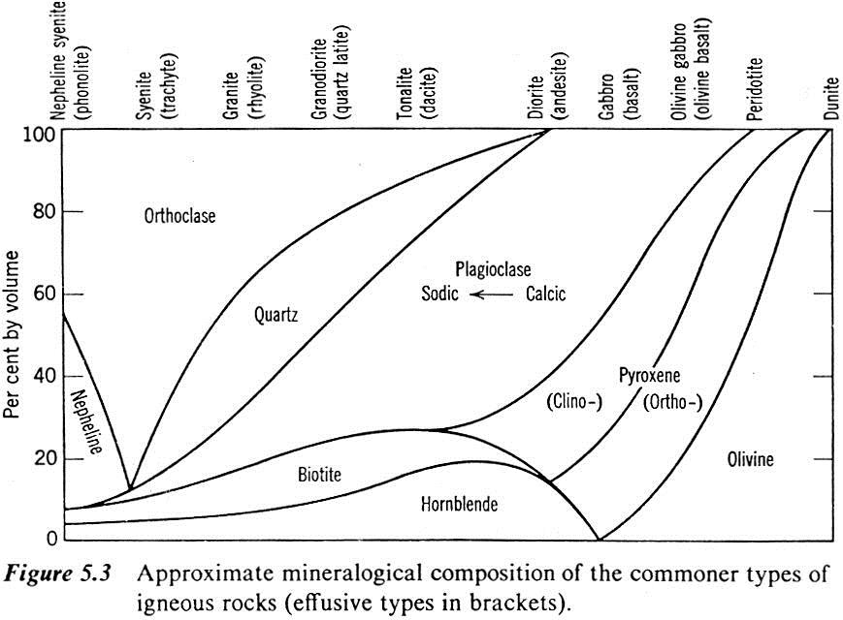
The major elements are found in different proportions in the main minerals of igneous rocks, and these minerals vary in proportion and composition with rock type.
Silicic Mafic
intermediate
ultramafic

Slide 11
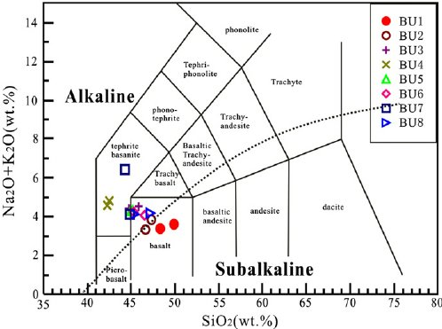
Igneous geochemistry
TAS diagrams
chemical classifications of the main volcanic and plutonic rock types in terms of SiO₂ and total alkalis (TAS = Na₂O + K₂O) concentrations in wt%.
Source: Yu et al., 2011

Slide 12
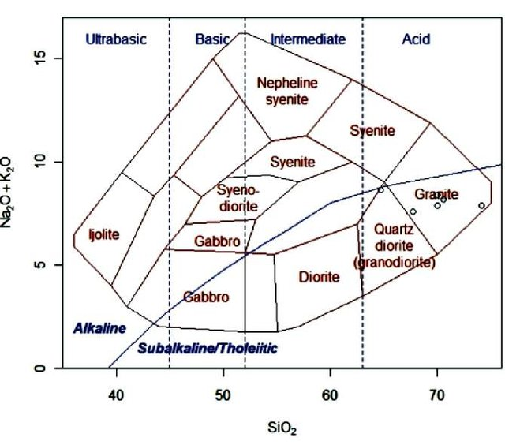
TAS diagrams in geochemistry
Source:Cox et al., 1979

Slide 13
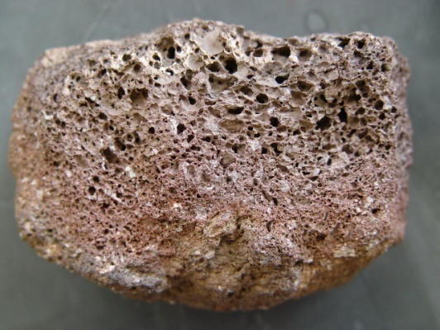
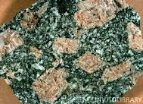
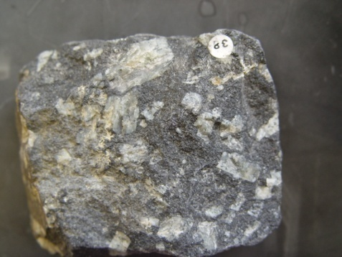
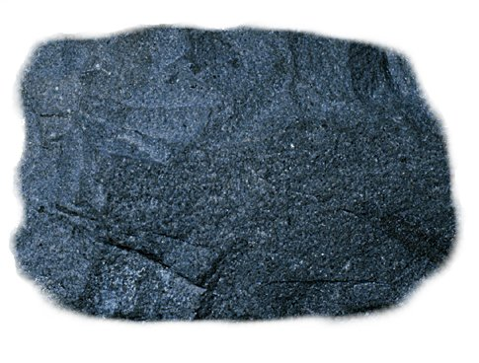
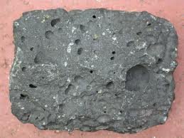
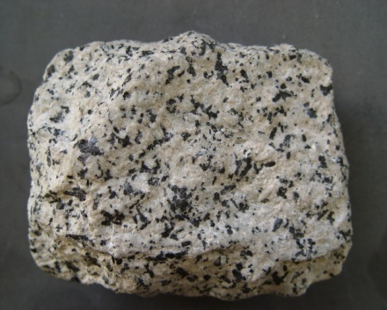
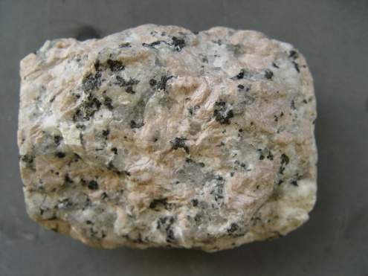
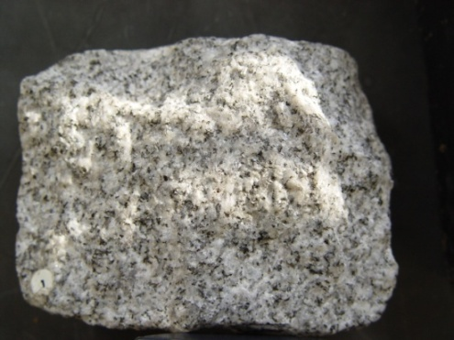
Why do we get so much variation in igneous rocks?
Over 700 types of igneous rocks are found.

Slide 14
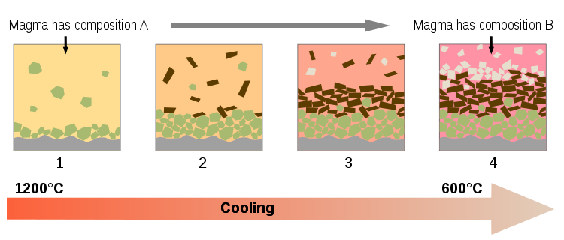
Magmatic Differentiation

Slide 15
Mechanism of Differentiation
Fractional Crystallization
Liquid Immiscibility
Assimilation

Slide 16
Fractional Crystallization
Most dominant mechanism of magmatic differentiation.
Fractional crystallization is the segregation and removal of crystallized minerals from a melt, which changes the composition of the melt.

Slide 17
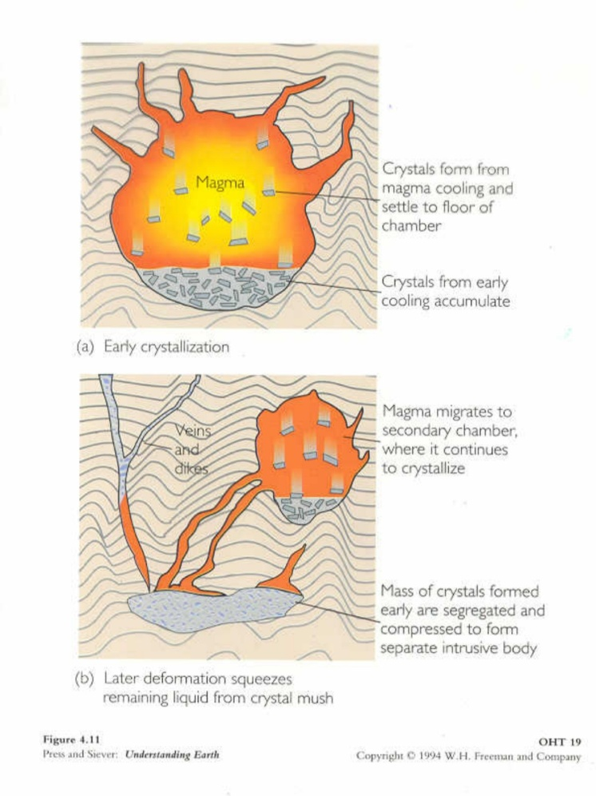
The process of Fractional Crystallization involves the separation and preservation of early-forming minerals, usually due to density differences.
Figure A show CRYSTAL SETTLING (a form of FRACTIONAL CRYSTALLIZATION.)
Figure B show MAGMA MIGRATION (another form of FRACTIONAL CRYSTALLIZATION.)

Slide 18
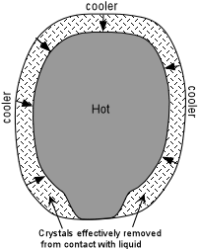
Fractional Crystallization
Gravity plays a very important role in settling of early formed crystals from the melt.
Parting between crystals and melt within a magmatic body may also be observed in flowing magma (documented in many dykes and sills), where greater concentration of large sized crystals commonly occur at the core (inner part) of dyke or sill (slow cooling at inner region so crystal grow in large size). This is known as Flowage Segregation.

Slide 19
Tectonic movements and some time the “Filter Pressing”- this mechanism has been proposed as a way to separate a liquid from a crystal-liquid mush.
stage | Process | Effect on Magma Chamber
1. Crystallization Begins | Early-formed minerals (e.g., olivine, pyroxene, plagioclase) start crystallizing from magma. | Formation of a crystal-liquid mush with interstitial melt.
2. Crystal Accumulation | Crystals settle at the base of the magma chamber due to gravity (cumulus crystals). | Crystal-rich layers start forming, while melt remains trapped.
3. Pressure Increases | Overlying material and continued crystallization increase pressure on the mush. | Crystals begin compacting, forcing melt to migrate.
4. Melt Migration (Filter Pressing Occurs) | Interstitial melt is squeezed out due to compaction and stress. | Residual melt moves upward, leaving behind a more solidified layer.
5. Differentiation of Melt | Expelled melt becomes enriched in felsic components (Si, Na, K, volatiles). | Can lead to the formation of pegmatites or felsic intrusions.
6. Layered Igneous Rock Formation | Crystal-rich layers solidify, and melt-depleted rocks remain below. | Development of layered mafic intrusions, compositional zoning in magma chambers.

Slide 20
Bowen’s Reaction Series
N.L. Bowen (1928) explained magmatic differentiation through Fractional Crystallization, known as Bowen’s Reaction Series.
It describes the sequential crystallization of minerals during magma cooling, determining whether the magma solidifies into a single rock type or diversifies into multiple rock types.

Slide 21
According to Bowen’s Reaction Principle “ As crystallization of magma starts, there is a tendency for equilibrium to be maintained between solid (crystals) and liquid (residual melt) phases. To maintain this equilibrium, the early formed crystals (unless removed from the melt) react with the residual melt and change in composition (formation of new mineral) takes place”.
Bowen’ Reaction Principle illustrates how a primary basaltic magma may give rise granite or other igneous rocks (depending upon the degree of crystallization and reaction of early formed crystals with melt or removal of these crystals from the melt.

Slide 22
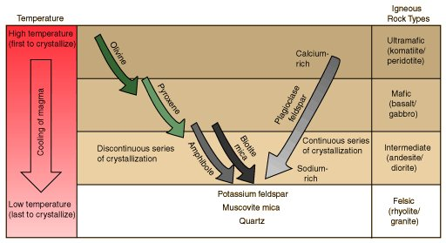

Slide 23
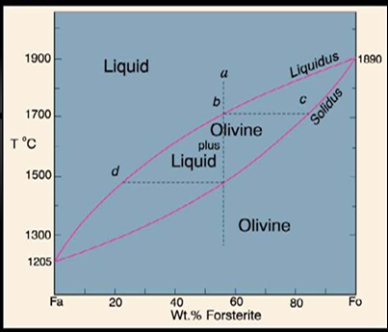
Solid solution series-Olivine

Slide 24
Discontinuous Series: At lowering of temperature (cooling starts), first mineral to crystallized is “Olivine”. As soon as it formed (unless it removed from the melt), with falling temperature the “Olivine” react with the melt and convert into “Mg-Pyroxene”. This will continue till whole “Olivine” get convert into “Mg-Pyroxenes”.
Later on the reaction remain continue and “Mg-Pyroxene” (unless removed from the melt), react with the melt and convert into “Ca-Pyroxene” and then “Hornblende”, then “Biotite”, with the falling temperature.

Slide 25
Continuous Series: At lowering of temperature (cooling starts), first plagioclase to crystallized is rich in Ca (Ca-Plagioclase). As the reaction goes on and temperature drops, the crystals become more and more sodic (unless remove from the melt).
The Potash Felspar and Muscovite are formed at later stages and the last formed mineral is “Quartz”.

Slide 26
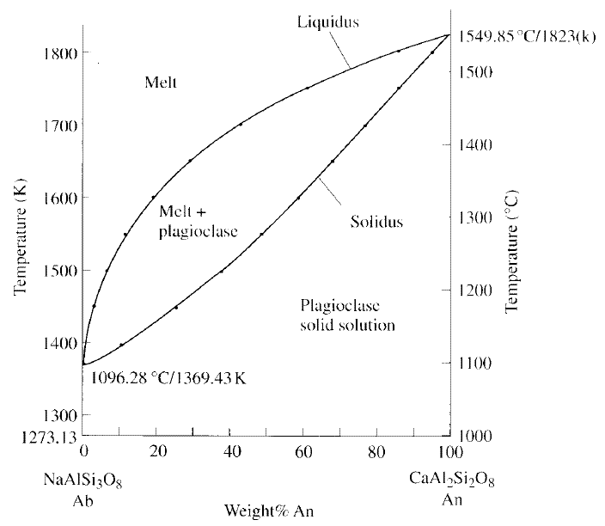
Solid solution series- Anorthite

Slide 27
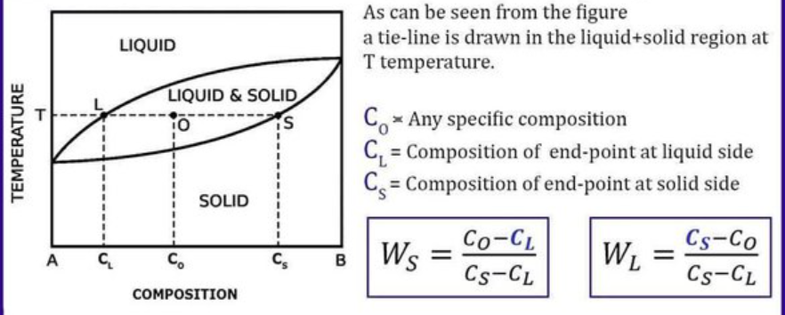
Lever rule

Slide 28
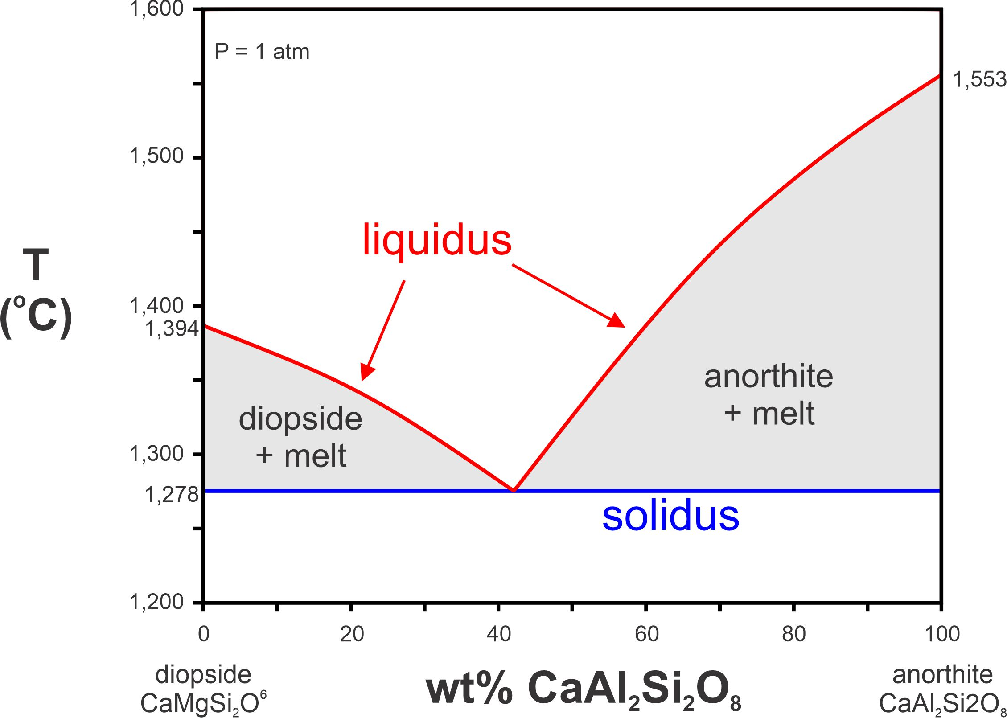
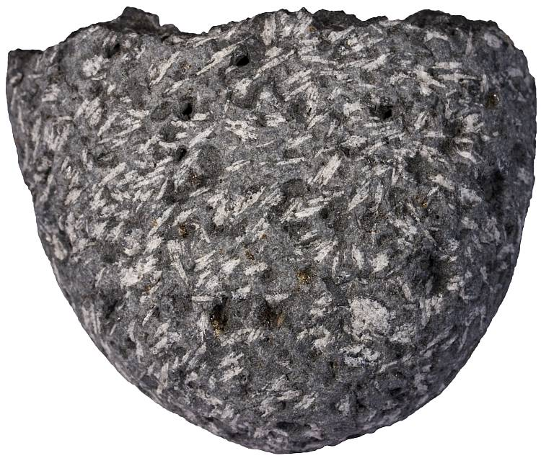
Binary eutectic system

Slide 29
Liquid Immiscibility
Laboratory experiments have shown that the Liquid Immiscibility also play an important role in magmatic differentiation and diversification of igneous rocks.
It is believed that a homogenous liquid magma on cooling, split into two immiscible liquid fractions (having different composition).
For e.g. a Tholeiitic liquid magma on cooling may split into two fractions (a) Granitic melt (b) Fe-Mg rich melt.

Slide 30
Tholeiitic Magma
Cooling
Granitic Melt
Fe-Mg rich Melt
Likewise, from mafic silicate magmas, Sulfide liquids may separate as immiscible fraction.
Similarly, highly alkaline magmas rich in CO₂ may separate into two liquids, one rich in carbonate, and the other rich in silica and alkalis. This process may be responsible for forming the rare carbonatite magmas. Carbonatites (alkaline igneous rocks) are commonly generated through the process of liquid immiscibility.

Slide 31
Assimilation
Assimilation is another process of responsible for diversification of igneous rock types.
Assimilation is the incorporation of matter from wall rocks into the magma to give a contaminated or hybrid magma.
During the intrusion of magma in wall rocks, some of the fraction of wall rock mixed in the magma and may become partially or completely melted (due to heat of magma) and merged into the liquid fraction of magma (causing change of composition of primary magma).

Slide 32
According to the Bowen (1928), a considerable amount of heat is necessary to melt the minerals of country rocks.
For the process of assimilation, magmatic temperature should be high otherwise only those minerals of wall rock will melt, which are having lower melting temperature. Wholesale (Bulk) assimilation by a liquid magma requires a superheated magma (very high temperature).
The presence of xenoliths (fractured portion of country rocks) is indicative of assimilation.

Slide 33
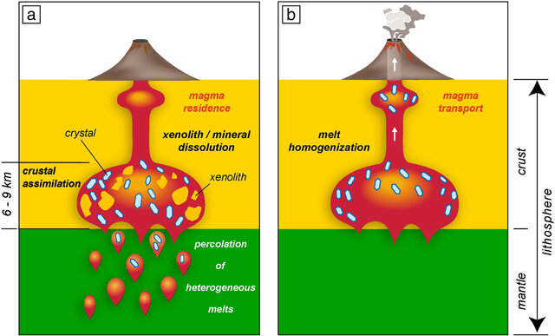

Slide 34
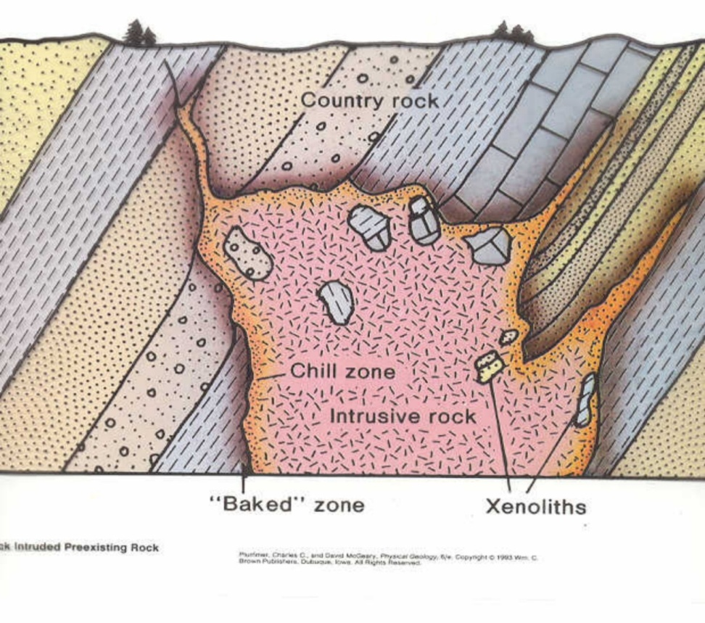
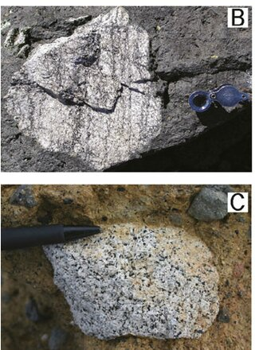

Slide 35
Magma Mixing
The process of magma mixing is also responsible for variation in igneous rocks.
Bunsen (1851) first suggested that the mixing of two contrast primary magmas (basaltic and rhyolitic) may account for the range of variation in the lava. Later on Durocher (1909) explained that all igneous rocks are derived from two primary magma only.
Magma mixing do occur in nature but petrologists do not consider it as the principal factor in magmatic evolution.

Slide 36
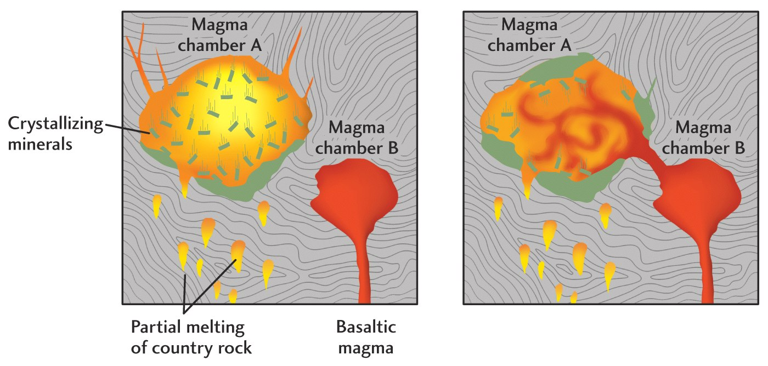
The magma mixing may be partial or complete. In partial mixing, the separate body or xenolith on one magma type is found in another. If it mixed completely, then it form a magma of different composition (hybrid magma).

Slide 37
magma mixing into two separate physico/chemical processes:
(i) mechanical mixing (also referred to as “magma mingling”), by which two or more batches of magma mingle without chemical exchanges between them,
(ii) a chemical mixing (also referred to as “magma mixing”) triggered by chemical exchanges between the interacting magmas in which elements move from one magma to the other according to compositional gradients continuously generated by the mechanical dispersion of the two magmas

Slide 38
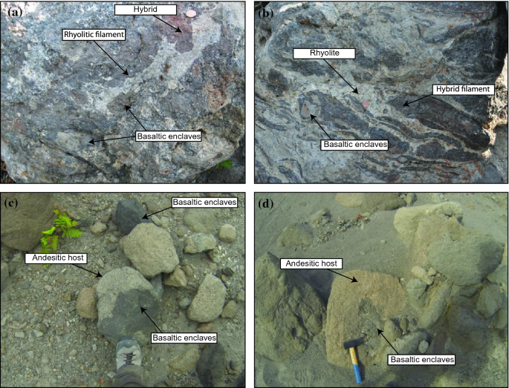

Slide 39
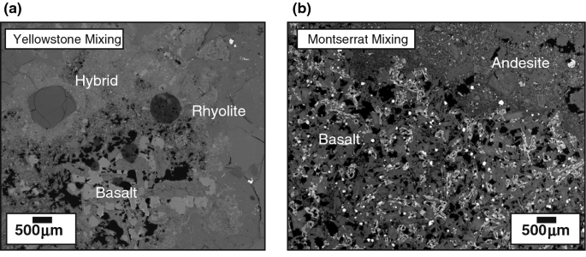
Source: Morgavi et al., 2017
Magma Mixing

Slide 40
Trace elements during magmatic differentiation

Slide 41
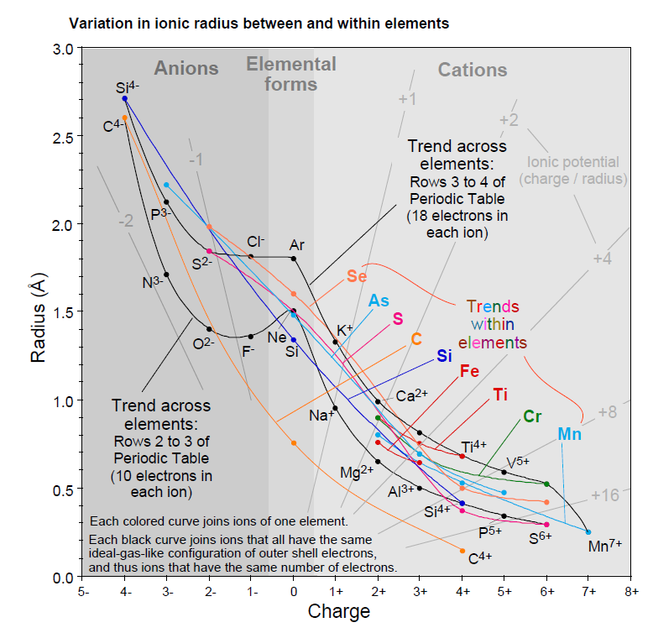
Ionic Radius and substitution

Slide 42
GOLDSCHMIDT’S RULES
1. The ions of one element can extensively replace those of another in ionic crystals if their radii differ by less than approximately 15%.
2. Ions whose charges differ by one unit substitute readily for one another provided electrical neutrality of the crystal is maintained. If the charges differ by more than one unit, substitution is generally slight.
3. When two different ions can occupy a particular position in a crystal lattice, the ion with the higher ionic potential forms a stronger bond with the anions surrounding the site.

Slide 43
RINGWOOD’S MODIFICATION OF GOLDSCHMIDT’S RULES
4. Substitutions may be limited, even when the size and charge criteria are satisfied, when the competing ions have different electronegativities and form bonds of different ionic character.
This rule was proposed in 1955 to explain discrepancies with respect to the first three Goldschmidt rules.
For example, Na⁺ and Cu⁺ have the same radius and charge, but do not substitute for one another.

Slide 44
Coupled Substitution
When the ion of a major element in a mineral is replaced with something having a different charge, the charge imbalance created must be neutralized by addition of a counter ion
Example → addition of Al³⁺ in a silicate structure (replacing Si⁴⁺) requires addition of a Na⁺ or K⁺ (Key to understanding feldspar chemistry…). When 2 Al³⁺ are added for Si⁴⁺, this then can be balanced by adding a Ca²⁺ ion

Slide 45
SOLID SOLUTION
Occurs when, in a crystalline solid, one element substitutes for another..
The garnet is a solid solution of the following end member components:
Pyrope - Mg₃Al₂Si₃O₁₂; Spessartine - Mn₃Al₂Si₃O₁₂;
Almandine - Fe₃Al₂Si₃O₁₂; and Grossular - Ca₃Al₂Si₃O₁₂.

Slide 46
Partition coefficient or Distribution coefficient
It is assumed that at equilibrium, the ratio of concentration of a trace element in a solid phase (C_{s)} to its concentration in liquid (C_{L}) is a constant (D):
D= C_{s}/C_{L}
The constant is called PARTITION COEFFICIENT or DISTRIBUTION COEFFICIENT or NERNST PARTITION COEFFICIENT.
It is also denoted as K_{D}
Eg: Silicate melt
500 ppm of Sr in a plagioclase phenocryst
125 ppm of Sr in glassy matrix
K_{D} of Sr for that melt is 4

Slide 47
Partition coefficient or Distribution coefficient - 2
If K_{D} = 1, then trace element is equally distributed between mineral and melt
If K_{D} = > 1, then trace element has a ‘preference’ for mineral phase & in the mineral-melt system under investigation and is a compatible trace element.
If K_{D} = < 1, then trace element has a ‘preference’ for melt phase & in the mineral-melt system under investigation and is a incompatible trace element.

Slide 48
BULK PARTITION COEFFICIENT
A rock is an aggregate of minerals, so the Bulk distribution coefficient for a rock for a specific element can be calculated from partition coefficients of constituent minerals weighed according to their proportion. It is defined by expression
D_{i} = x₁ K_{d1} + X₂K_{d2} + X₃K _{d3}…
D_{i} = bulk partition coefficient for element I
X₁ = modal proportion of mineral 1 etc
K_{d1} = parition coefficient for element i in mineral1
For eg. In a rock containing 50% olivine, 30% Opx & 20% cpx, the bulk partition coefficient would be
D_{i} = 0.5 K^{ol}_{d1} + 0.3K^{opx}_{d2} + 0.2K^{cpx} _{d3}…

Slide 49
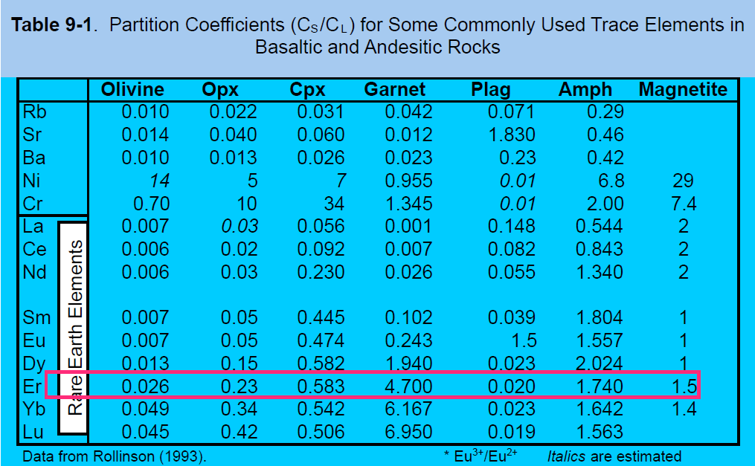
Example: hypothetical garnet lherzolite = 60% olivine, 25%, orthopyroxene, 10% clinopyroxene, and 5% garnet (all by weight), using the data in Table 9.1, is:
DEr = (0.6 · 0.026) + (0.25 · 0.23) + (0.10 · 0.583) + (0.05 · 4.7) = 0.366

